Slide 1


Madurai Tech Community
www.madurai-tech.org
Solution Brief
To be submitted before 2-Aug-2023
Team Coordinator Name | JAGADEESWARAN N
Team Coordinator Phone Nos | 7539952207
Team Coordinator email | waranjagadees95@gmail.com
Team Name | Team Phoneix
Team members names | NEGAVARSHINI S
Team members emails | negavarshini142002@gmail.com
Problem Statement Taken | Map Based Parking Application

Slide 2
Research done to arrive at the solution
1. The Research are been done at various journals.The names of the Journals are
i.https://parklio.com
ii.ttps://phpgurukul.com
iii.www.academia.edu
iv. News 7 Tamil (Reference about parking problem)
2. The application is been devoloped to provide right suggestion of the parking management.The Data are been stored in secured manner.
3. We Visited the places like Vishal de mall,Supermarts and Temples and analyse that parking problem is not only affect the people it also make a heavy traffic in main areas.
4. We collected the datas like due to some parking areas are not visible to the drivers in right way.Hence they park the vechiles in unneccesary places.

Slide 3
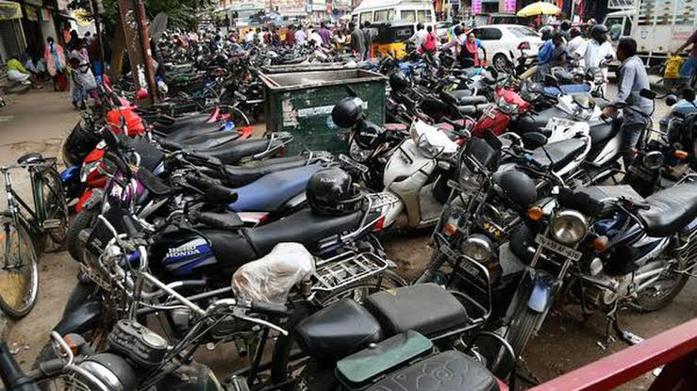
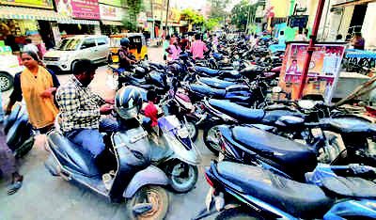
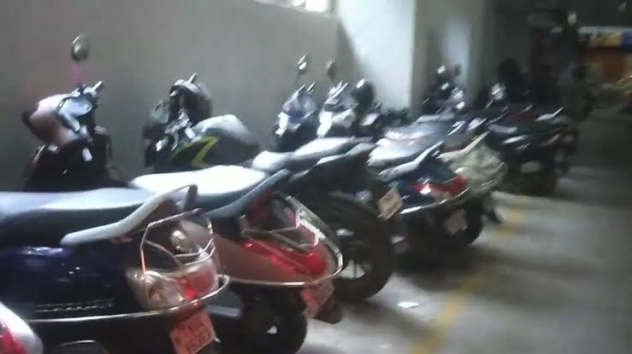
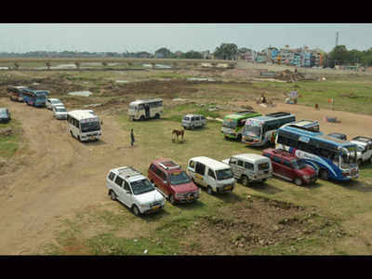
Sample Images
ANNA NAGAR MADURAI
ANNA NAGAR MEENAKSHI AMMAN TEMPLE VISHAL DE MALL PARKING
(SOUTH GOPURAM STREET)
VAIGAI RIVER DAM (Referred from News 7 Tamil )

Slide 4
Outline of the solution
Users:
All people have a vehicle for travel.But they do not have a proper place to park in public places.So all the people are our users.
Functional Features:
Real time searching of parking places
Booking
GPS Tracking
Easy payments
Supportized product

Slide 5
Technical Features
Vehicle and Employee scheduling
Track parking spaces
Manage visitors
Better Revenue streams
Business Scalability

Slide 6
Value
The main aim for create this project is not only to solve the parking problems in the public areas.If the parking problems occurred in the public places it will affect the Traffic and also the people.
The solution for this problem is to identify the proper parking places and also been helpful for reduce the traffic problems in the cities.
Due to heavy traffic it also affects the Air quality in the Environment in the major population cities like Chennai and devoloped Smart city Madurai.

Slide 7
Reuse
Reused:
We know that there are some of the application like “SPOTHERO”,”YOUR PARKING SPACE”. The same methodology is done in our project.GPS along with map facilities is easily used to find the parking areas around the specified location.
Changes done by Ours:
The main disadvantages of the existing product is System Breakdown,Requires regular maintainence and other charges.These are rectified according to the peoples requestion and reduced by our team. If we get a proper funding process we planned to implement voice recognizition with this process
to guide the unliteracy people(who don’t understand English and other languages).

Slide 8
Feasibility
Human resource effort:
The system is help to reduce the congestion and improve traffic flow. Effective parking management also help to prevent the accidents in major places.
Time:
The project is planned to done in our college project and completed
Successfully.After know about the same content in the Entrepreneurship
we upgrade some facilities and collect the data around Madurai region and complete in 12 days.Maximum period to complete the whole project is 4 months.

Slide 9
Material cost:
S.NO | SOFTWARE REQUIREMENTS | ESTIMATED BUDGET
1. | Devolopment of Coding | Rs.4000
2. | Scope Creep | Based on Agreement
3. | Testing | Estimation Based Testing
4. | Marketing | Rs.500+(Hour based)
5. | Database Storage | Rs.8000+(Database approve based storage)
6. | Securance Data | No Specified Charge
7. | Maintainence process | Rs.2000-6000(According to 2023 INSTRUCTIONS)

Slide 10
Practicality:
Compare to Desktop applications,Web based application provide a whole range of uses.These applications can be accessed by Computers or Mobile phones.
Web based Parking Application is easily installed by all Android users and also been easily tracked the parking places all over the location.
Practically it is very easy and secure application for all people.

Slide 11
Road map to implement
Design the project model Devolop coding process Implementation and First review
Discuss with project Experts
Data collection around Madurai Successfull Implementation
Final review completion Deducte errors
and Documentation(Github)
15-03-23
24-03-23
03-04-23
28-03-23
06-04-23
20-07-23
25-04-22
15-04-23
PROJECT COMPLETION
(28-07-2023)

Slide 12
.
THANK YOU TO ALL

